Slide 1
Single Site
Initiatives
Workloads
Workloads
Workload 1
Workload 2
Workload 3
Edit I
Virtualization
Virtualization
Edit V
Compute
Compute
Edit C
Challenges
Network
Network
Edit N
Ch Edit
Storage
Storage
Edit S
Data Protection
Data Protection
Edit R
Edit B

Slide 2













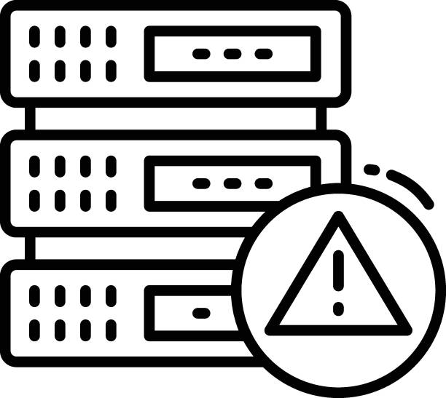

Workloads

Slide 3
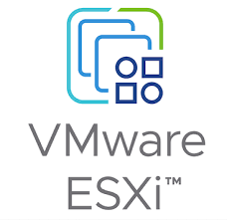
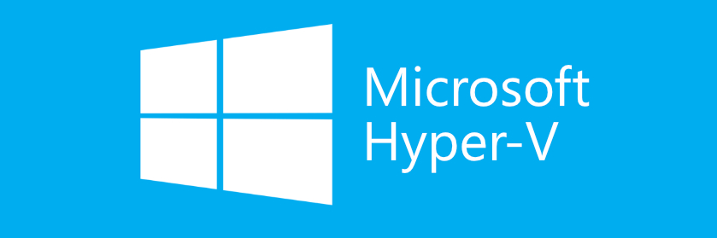
Virtualization

Slide 4
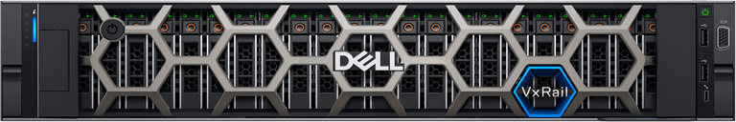
Compute

Slide 5
Networking

Slide 6
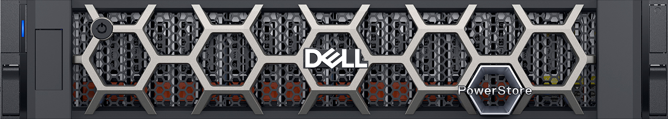
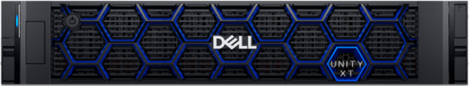
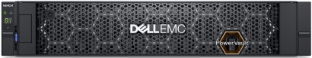
Storage

Slide 7


Replication

Slide 8




Backup

